Slide 1
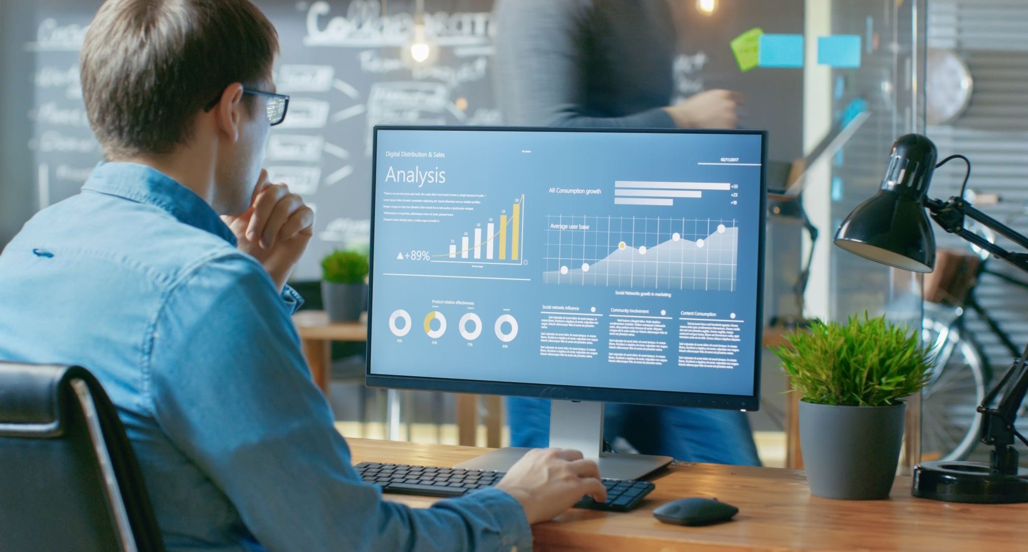
CYBER SECURITY ANALYSIS OF “GREEN ROOMS”

Slide 2
According to the latest Cyber Security Breaches Survey 2021, “four in ten businesses (39%) and a quarter of charities (26%) report having cyber security breaches or attacks in the last 12 months.”
- https://www.gov.uk/government/statistics/cyber-security-breaches-survey-2021/cyber-security-breaches-survey-2021

Slide 3
Physical Controls
Identification
Data Centre Security
Reception Area
Fires and Flooding
Security Camera
Security Guard
Entrance and Exit

Slide 4
Procedural Controls
Protection of Information
Backup
Responsibilities of Manager
Cyber Awareness

Slide 5
Technical Controls
Secure Access
Downloading Software
Accessing Files
Network Security
Dubious Websites

Slide 6

Network Security
Encryption
Antivirus
Switch
Data Line
Remote Desktop Protocol (RDP)
Firewall
Company Laptops equipped with VPN
Removable Media
Two-factor Authentication or 2FA?
CAPTCHAs?

Slide 7

thank you for listening

